Slide 1
Emitter Localization
Emre Tuncer 20291173
Bahadır Yanık 20290508

Slide 2
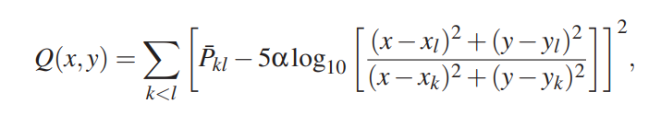
Background Information
In this study “non-linear least square” method that is an algorithm of power difference of arrival have used. The fundamental idea behind the power difference of arrival (PDOA) is that signal power level data from a variety of sensors can be used to infer a position by applying an appropriate path loss model.
B.R. Jackson., S. Wang, &R. Inkol (2011). "Emitter geolocation estimation using power difference of arrival. An algorithm comparison for non-cooperative emitters ". URL:https://cradpdf.drdc-rddc.gc.ca/PDFS/unc110/p534968_A1b.pdf

Slide 3

Interface of Program

Slide 4
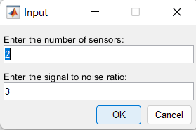
Interface of Program

Slide 5
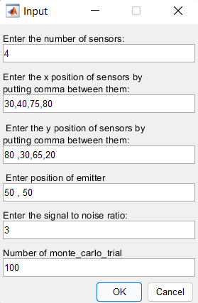
Interface of Program

Slide 6
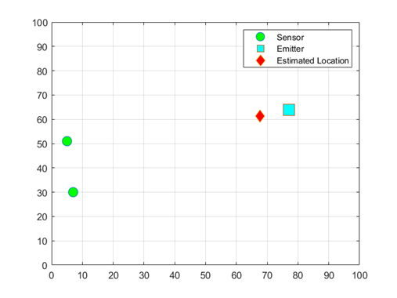
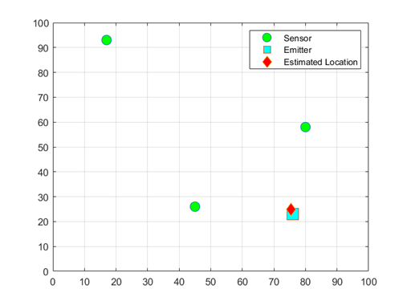
The Effect of the Number of Sensors
2 Sensors: MSE =1177.49
3 Sensors: MSE =198.64
:

Slide 7
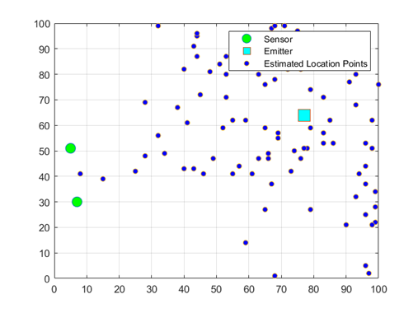
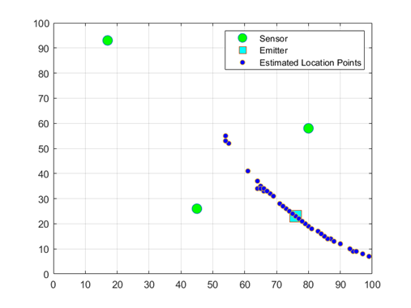
The Effect of the Number of Sensors
2 Sensors: MSE =1177.49
3 Sensors: MSE =198.64
:
Distribution of estimated points.

Slide 8
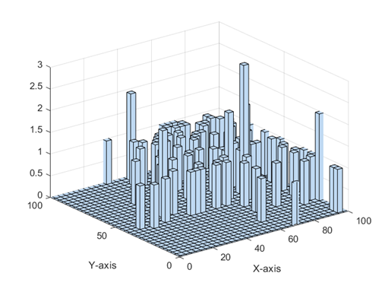
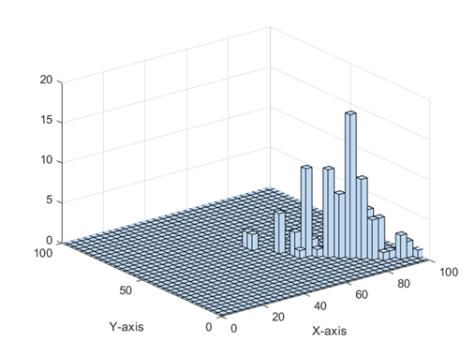
The Effect of the Number of Sensors
2 Sensors: MSE =1177.49
3 Sensors: MSE =198.64
:
The histogram of distribution of estimated points.

Slide 9
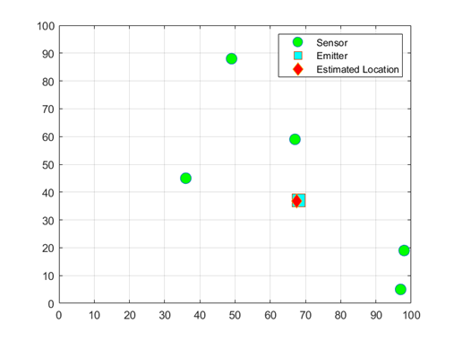
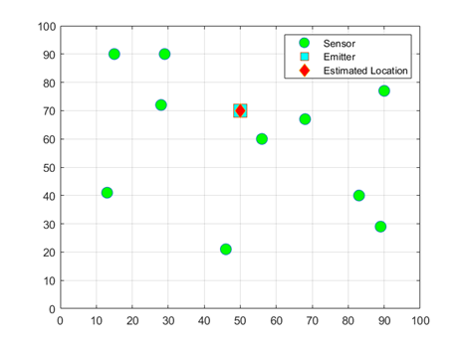
The Effect of the Number of Sensors
5 Sensors: MSE =11.66
10 Sensors: MSE =1.37
:
Distribution of estimated points.

Slide 10
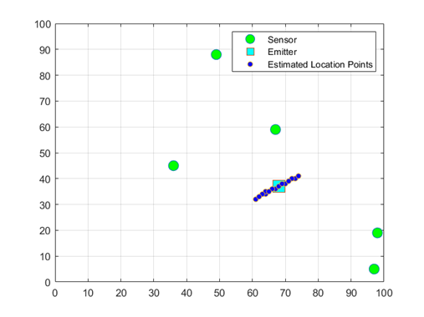
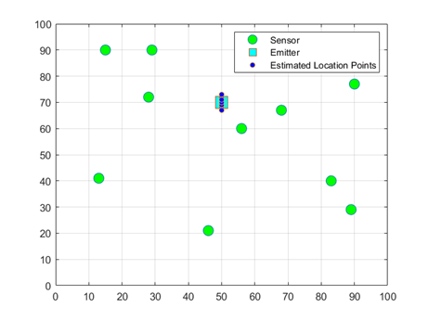
The Effect of the Number of Sensors
5 Sensors: MSE =11.66
10 Sensors: MSE =1.37
:
Distribution of estimated points.

Slide 11
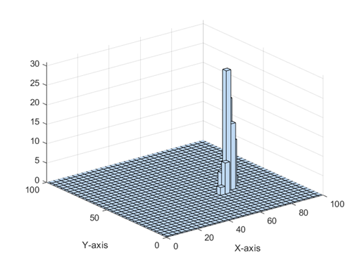
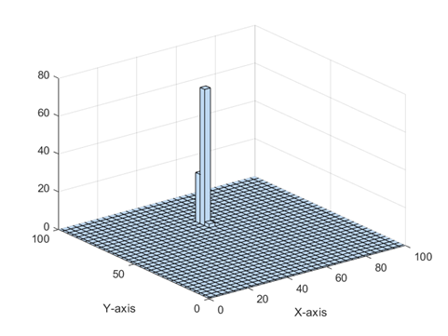
The Effect of the Number of Sensors
5 Sensors: MSE =11.66
10 Sensors: MSE =1.37
:
The histogram of distribution of estimated points.

Slide 12
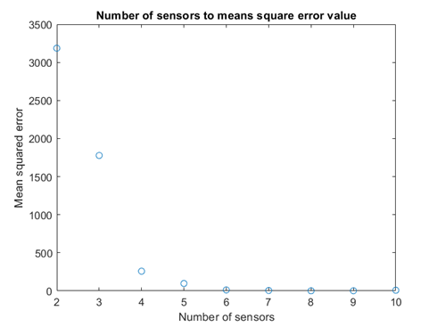
The Effect of the Number of Sensors

Slide 13
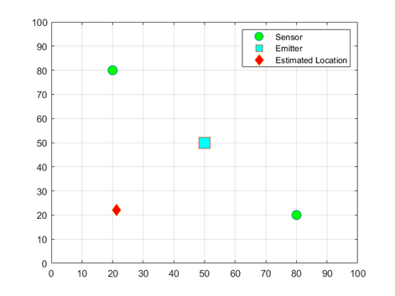
Effect of the sensors distribution on location accuracy
2 sensors distributed at same distance to emitter:
The mean square error value is 2330.54

Slide 14
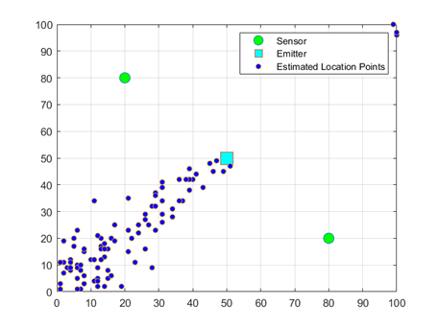
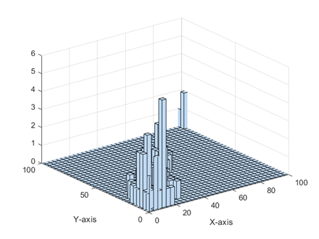
Effect of the sensors distribution on location accuracy
2 sensors distributed at same distance to emitter:
Distribution of estimated points.
The histogram of distribution of estimated points.

Slide 15
Effect of the sensors distribution on location accuracy
2 sensors distributed randomly on plane:
The mean square error value is 1177.49

Slide 16
Effect of the sensors distribution on location accuracy
2 sensors distributed randomly on plane:
Distribution of estimated points.
The histogram of distribution of estimated points.

Slide 17
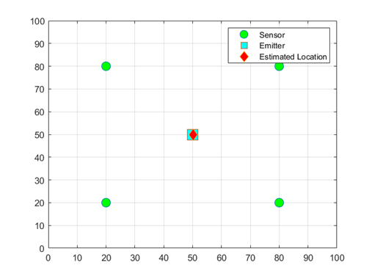
Effect of the sensors distribution on location accuracy
4 sensors distributed at same distance to emitter:
The mean square error value is 11.14.

Slide 18
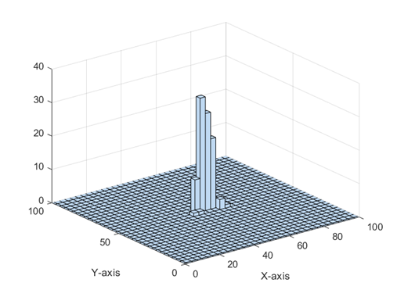
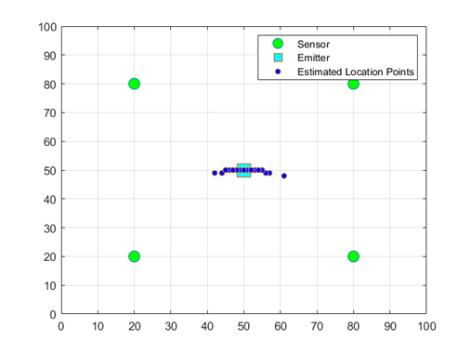
Effect of the sensors distribution on location accuracy
4 sensors distributed at same distance to emitter:
Distribution of estimated points.
The histogram of distribution of estimated points.

Slide 19
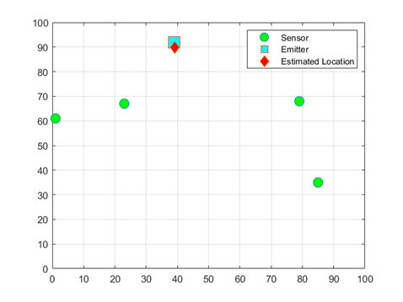
Effect of the sensors distribution on location accuracy
4 sensors distributed randomly on plane:
The mean square error value is 97.58.

Slide 20
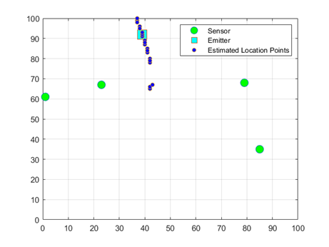
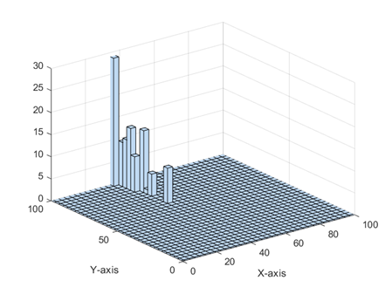
Effect of the sensors distribution on location accuracy
4 sensors distributed randomly on plane:
Distribution of estimated points.
The histogram of distribution of estimated points.

Slide 21
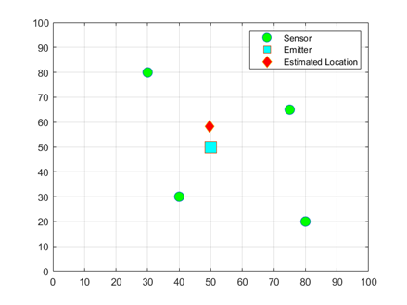
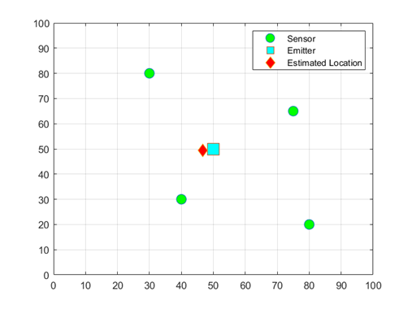
The Effect of the SNR Value
SNR = -10 dB
MSE = 743.56
SNR = -3 dB
MSE = 257.56

Slide 22
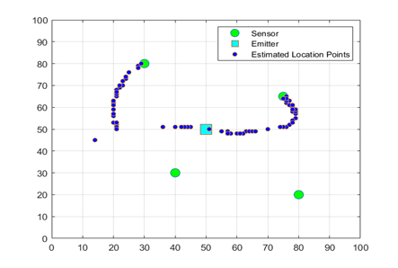
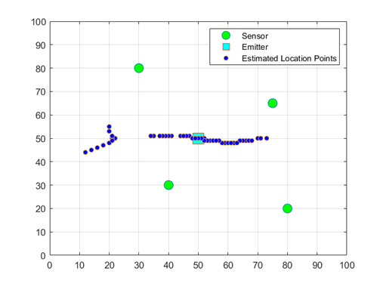
The Effect of the SNR Value
SNR = -10 dB
MSE = 743.56
SNR = -3 dB
MSE = 257.56
Distribution of estimated points.

Slide 23
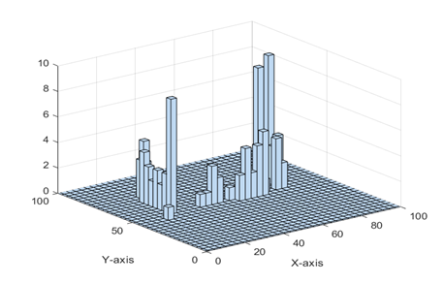
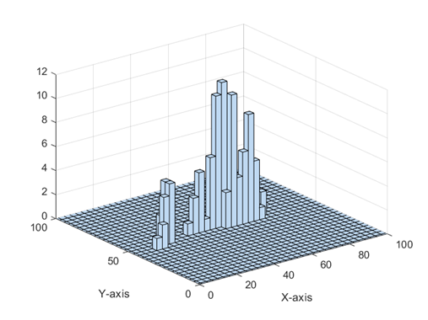
The Effect of the SNR Value
SNR = -10 dB
MSE = 743.56
SNR = -3 dB
MSE = 257.56
The histogram of distribution of estimated points.

Slide 24
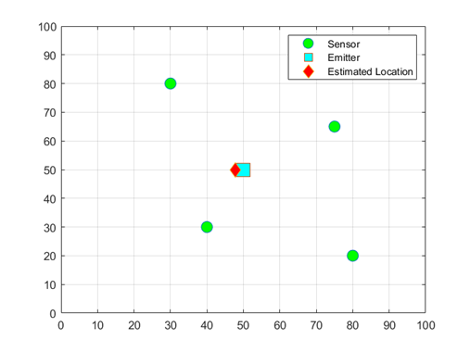
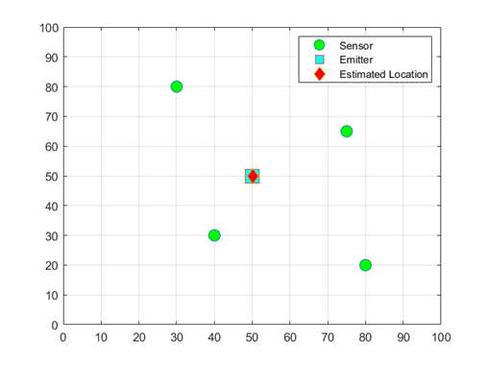
The Effect of the SNR Value
SNR = 0 dB
MSE = 95.83
SNR = 3 dB
MSE = 11.23

Slide 25
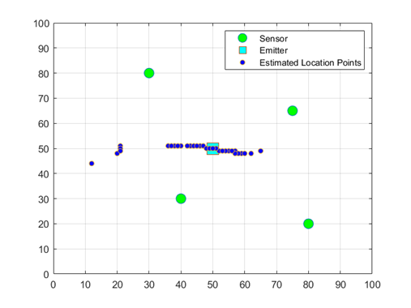
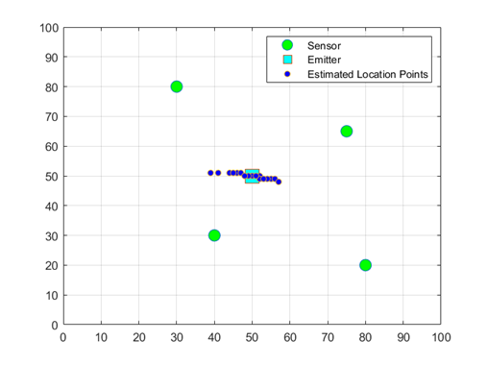
The Effect of the SNR Value
SNR = 0 dB
MSE = 95.83
SNR = 3 dB
MSE = 11.23
Distribution of estimated points.

Slide 26
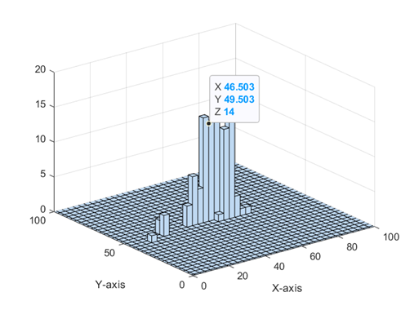

The Effect of the SNR Value
SNR = 0 dB
MSE = 95.83
SNR = 3 dB
MSE = 11.23
The histogram of distribution of estimated points.

Slide 27

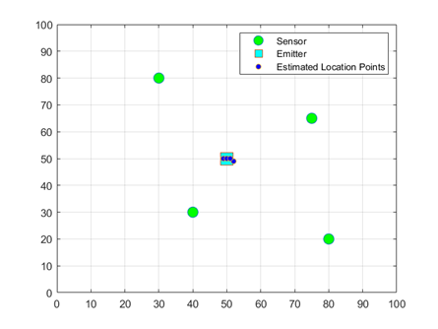
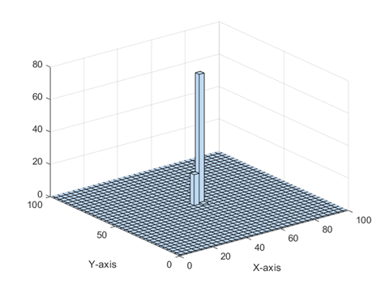
The Effect of the SNR Value
SNR = 10 dB
MSE = 0.44
The histogram of distribution of estimated points.
Distribution of estimated points.

Slide 28
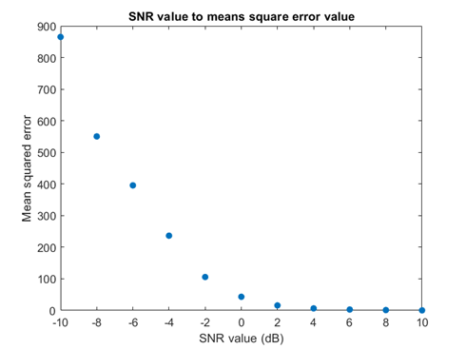
The Effect of the SNR Value

Slide 29
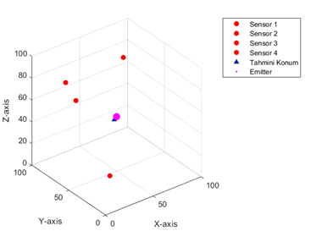
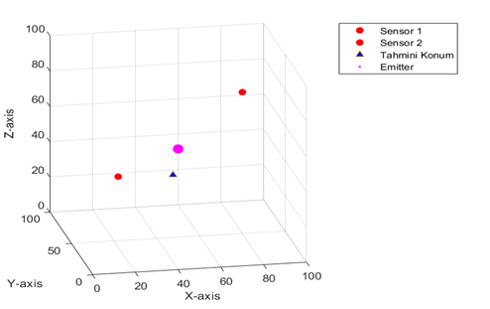
3D Model
2 Sensors: MSE =2595.02
4 Sensors: MSE =199.52

Slide 30
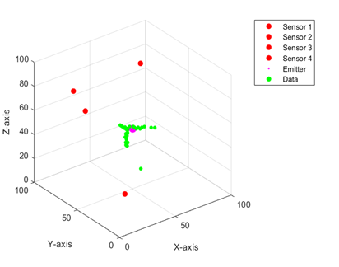
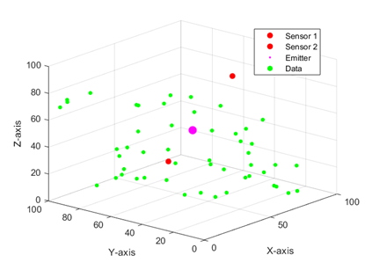
3D Model
2 Sensors: MSE =2595.02
4 Sensors: MSE =199.52
Distribution of estimated points.

Slide 31
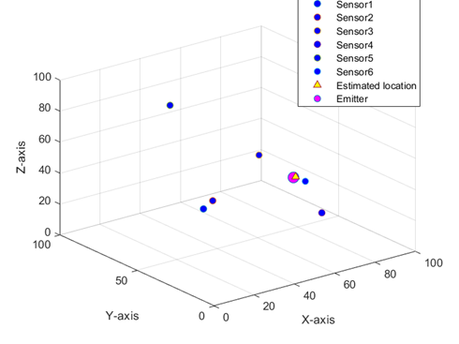
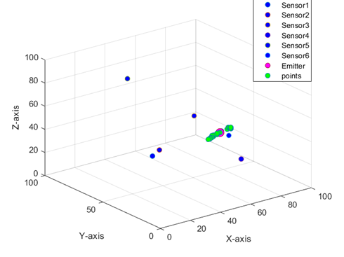
3D Model
6 Sensors: MSE =33.67

Slide 32
Conclusion
Our study reveals that increasing sensor count improves emitter location accuracy in both 2D and 3D models. However, accuracy diminishes with lower SNR and increased sensor noise. To achieve precise localization, it is crucial to maximize sensor count and minimize noise.

